Slide 1
Writing a character description
POEMA-CHARACTER

Slide 2
What do we need for describing character?
Adjectives
structures
Why do we describe character?
To tell friends
Somebody wants to read or watch book/film with this character
I can describe ….

Slide 3
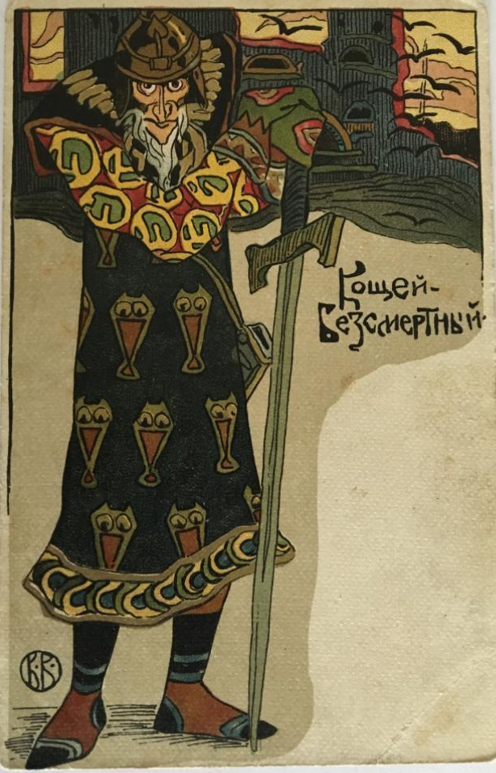
Describing a Character’s Appearance Koshchei Bessmertny
It is important that a character description allows the reader to picture what that character looks like.
sword
eyes
helmet
beard
Look at Koshchei Bessmertny. What features would you want the reader to picture? to picture?
jacket
nose
boots
cloak

Slide 4
Describing Character Poema-Character
First Line: Nickname/First Name
Second Line:
3 adjectives (temper)
Third Line:
(appearance)
Fourth Line:
Relationship (x of y)
Fifth Line:
3 things (interests)
Sixth Line:
3 things (afraid of)
Seventh Line:
3 things (see)
Eighth Line:
(live)
Last Name

Slide 5
Describing a Character Poema-Character
First Line: Nickname/First Name
Second Line:
3 adjectives (temper)
Third Line:
(appearance)
Fourth Line:
Relationship (x of y)
Fifth Line:
3 things (interests)
Sixth Line:
3 things (afraid of)
Seventh Line:
3 things (see)
Eighth Line:
(live)
Last Name
First Line:
Koshchei is
Second Line:
unfriendly, angry, greedy
Third Line:
Who has short grey hair, dark eyes, oval face, strong legs and arms
Fourth Line:
brother of Baba Yaga
Fifth Line:
Who likes gold, power, diamonds
Sixth Line:
Who is afraid of Ivan Tsarvich, needle in egg, summer
Seventh Line:
Who wants to see Paris, Elenu Prekrasnuj, all world
Eighth Line:
Lives in Palace
Bessmertny

Slide 6
Instruction
Choose the character
Use the plan and write poema-character
Control the time (10’)
Present your poema in our gallery-walk

Slide 7
Describing a Character Poema-Character
First Line: Nickname/First Name
Second Line:
3 adjectives (temper)
Third Line:
(appearance)
Fourth Line:
Relationship (x of y)
Fifth Line:
3 things (interests)
Sixth Line:
3 things (afraid of)
Seventh Line:
3 things (see)
Eighth Line:
(live)
Last Name
First Line:
…. is
Second Line:
….., ….., …..
Third Line:
Who has ….hair, …. eyes, …. face, …. legs and arms
Fourth Line:
….. of …..
Fifth Line:
Who likes …., …., …..
Sixth Line:
Who is afraid of …., …., ……
Seventh Line:
Who wants to see ….., ….., ……
Eighth Line:
Lives in …..
….
* - write 1st, 2nd, 3rd,5th,7th, last name.
** - write 1st, 2nd, 3rd,5th,6th,7th, last name.
*** - write from 1st to last name lines.

Slide 8
Feed gap
Can you describe the character?
It was interesting/useful/boring/fun? Why?

Slide 9
Home work
* - write 1st, 2nd, 3rd,5th,7th, last name.
** - write 1st, 2nd, 3rd,5th,6th,7th, last name.
*** - write from 1st to last name lines.
Write Poema-Character about your favourite
film-character or cartoon-character

Slide 10
Goodbye!

